Slide 1

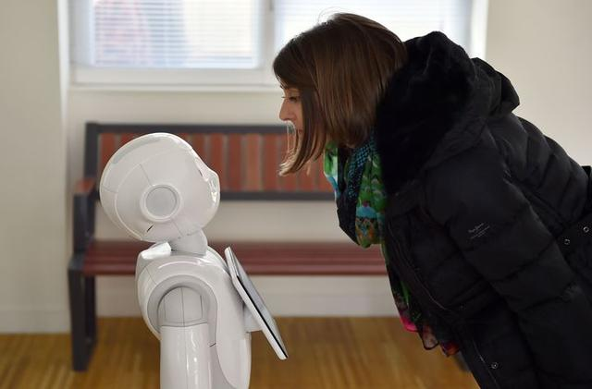
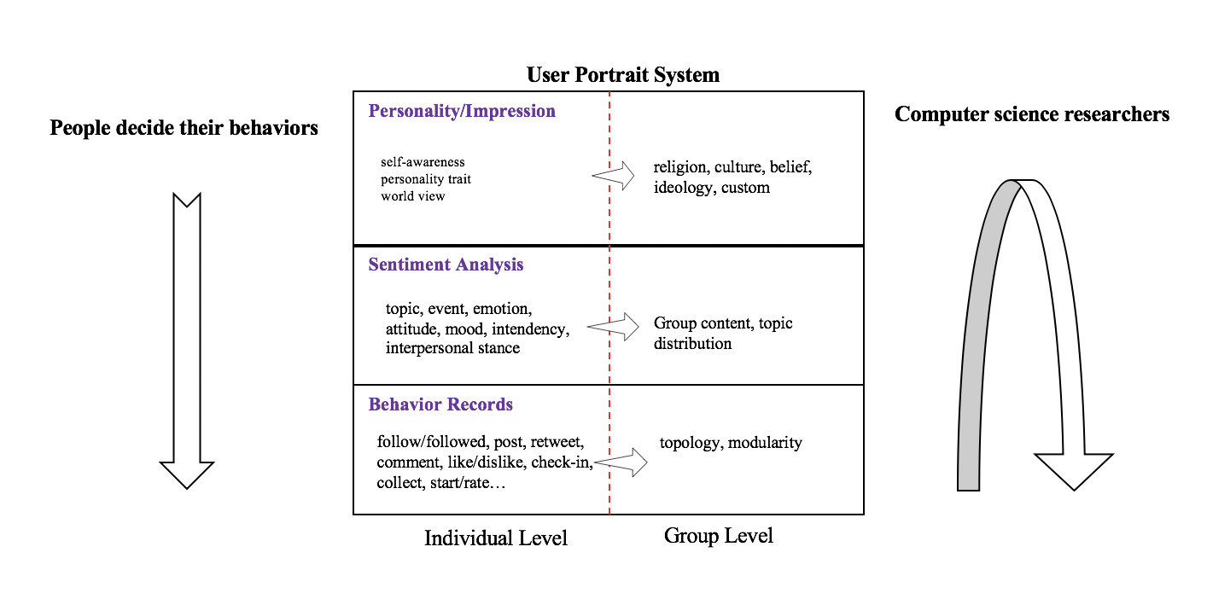
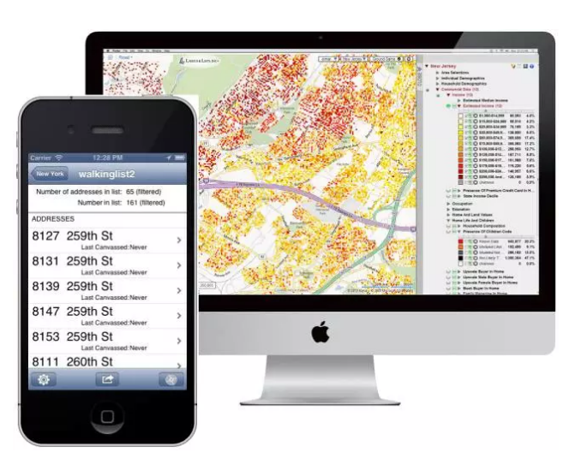


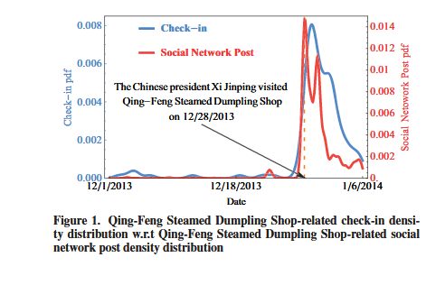

Appetizer/snacks before we start…
This is the INFS7450 online tutorial conducted by Xiangguo (Sheldon).
You see this slide because you come here earlier. Let’s wait for the other students to come. ☺
(Appetizer will not be recorded in the video and won’t be in our exam. )
chatbot
mental intervention
Applications of the user portrait system
Socially Aware
individual RecSys
Extravert Ad Introvert Ad
consumer behavior analysis
human resource management
Notes:
Conformity
Bioloogy approach

Slide 2
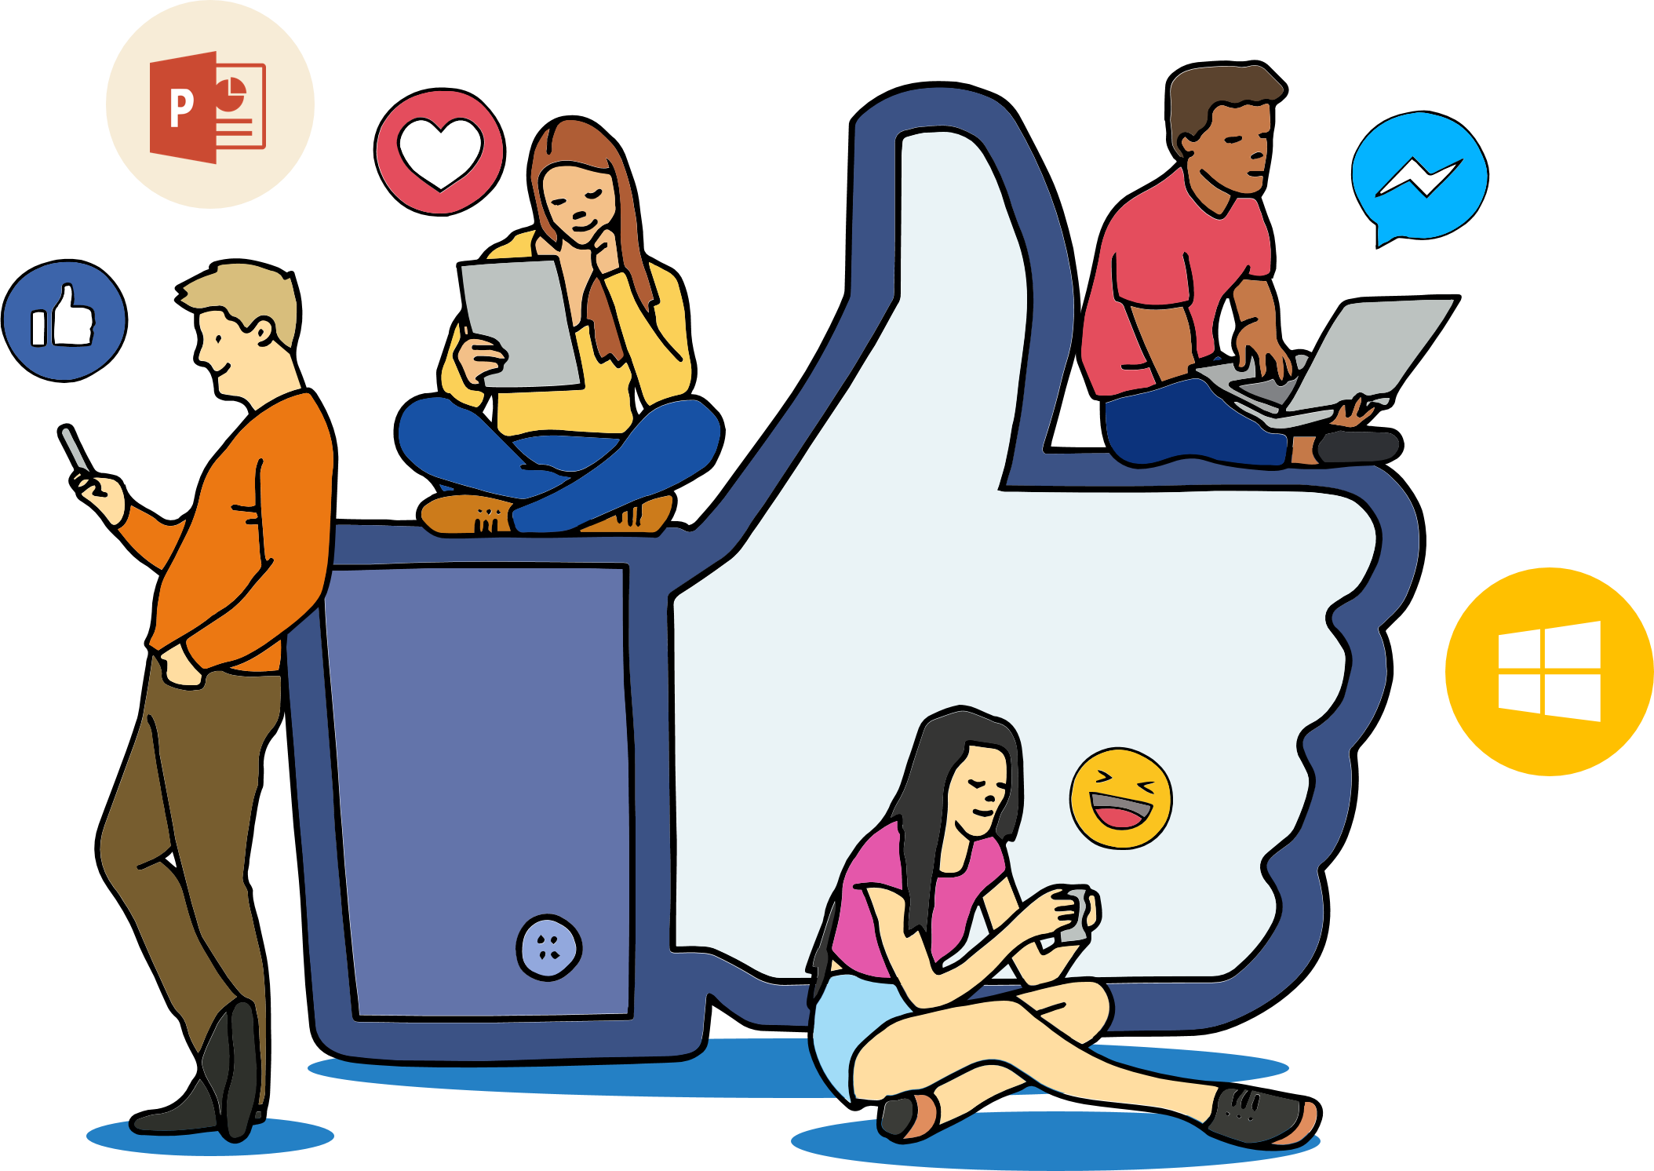
SOCIAL MEDIA ANALYTICS INFS7450
Tutorial Week 7
Xiangguo Sun
School of ITEE
The University of Queensland
Notes:
Hello everyone, this is Sheldon speaking, what you are watching now is my pre-recorded video for the tutorial talk.
When you are watching this video, I’m also in the meeting room and watching with you together. If you have any question, you just need to send me message via the chat button in this zoom app.

Slide 3
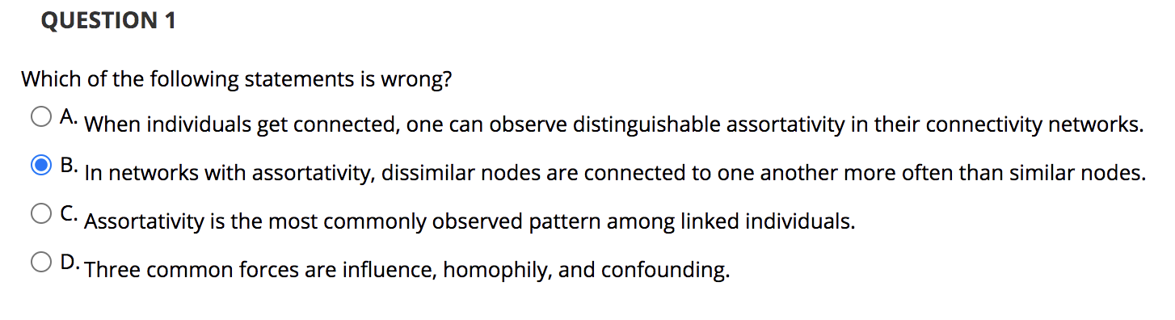
Online quiz 4

Slide 4

Why are connected people similar?
Influence
The process by which a user (i.e., influential) affects another user
The influenced user becomes more similar to the influential figure.
Example: If most of our friends/family members switch to a cellphone company, we might switch [i.e., become influenced] too.
Homophily
Similar individuals are more likely to become friends due to their high similarity
Example: Two musicians are more likely to become friends.
Confounding
The environment’s effect on making individuals similar and connected
Example: Two individuals living in the same city are more similar and more likely to become friends than two random individuals
Notes:
Before you are connected, maybe you are not similar; but after you are connected such as friends and couple, you become more and more similar as time goes on.
Homophily is a phenomenon that
You are living in the same city, sharing the same social and natural environment. Such as the similar food, culture and belief and even Gene, 'feðə

Slide 5
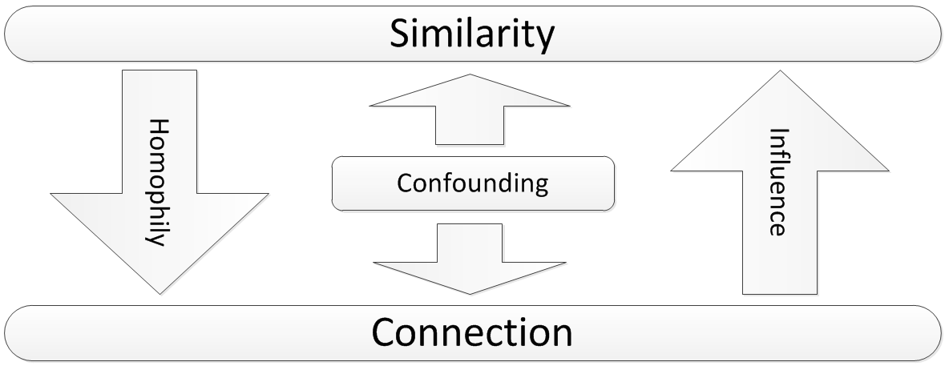
Influence, Homophily, and Confounding
Cause and Effect
Notes:
cause and effect

Slide 6
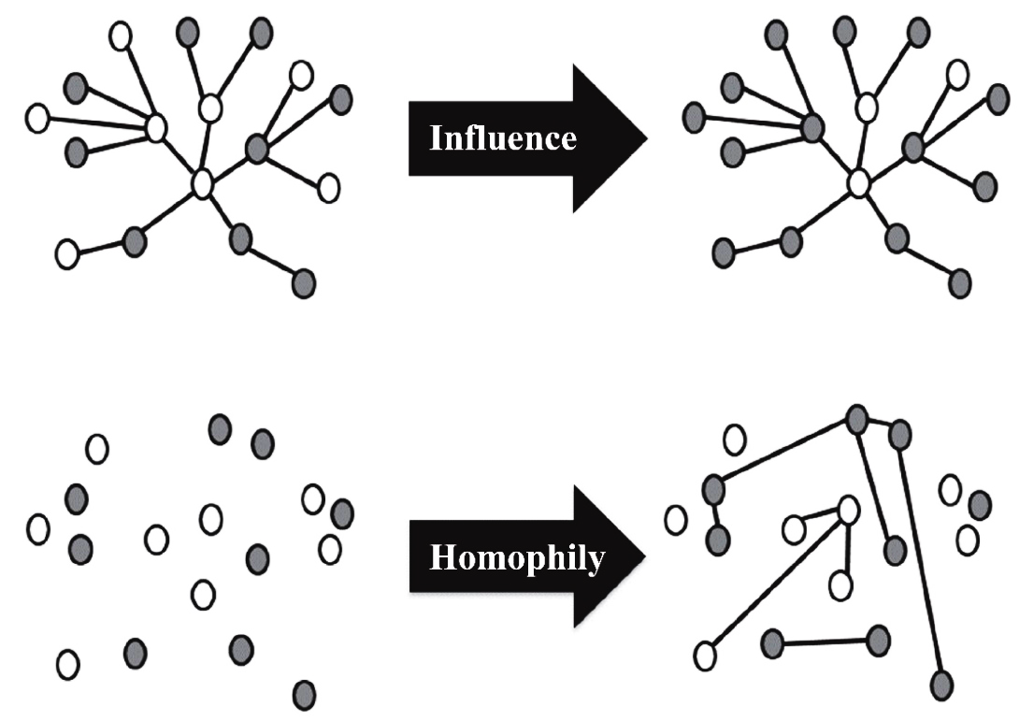
Source of Assortativity in Networks
Both influence and homophily generate social similarity in social networks
Influence
Makes connected nodes similar to each other
Homophily
Selects similar nodes to link together

Slide 7
Why?
Smoker friends influence their non-smoker friends (social conformity)
Smokers become friends
There are lots of places that people can smoke, and smoking is a type of local culture
Influence
Homophily
Confounding

Slide 8
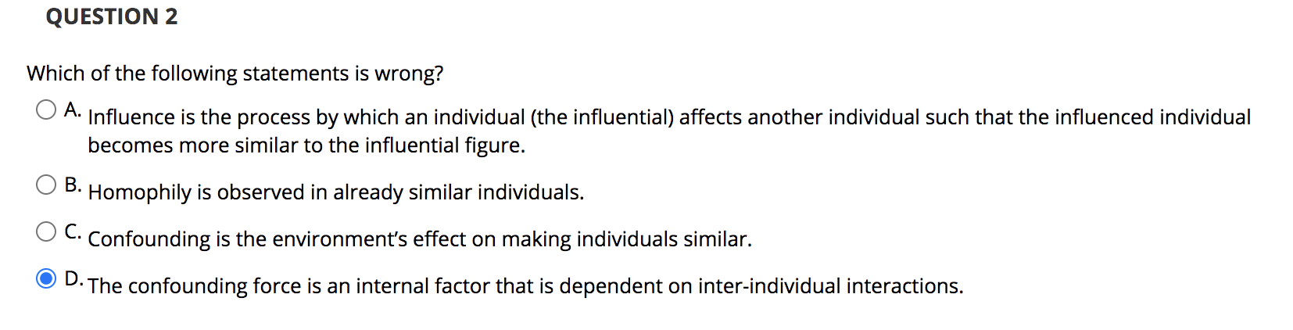
Online quiz 4

Slide 9
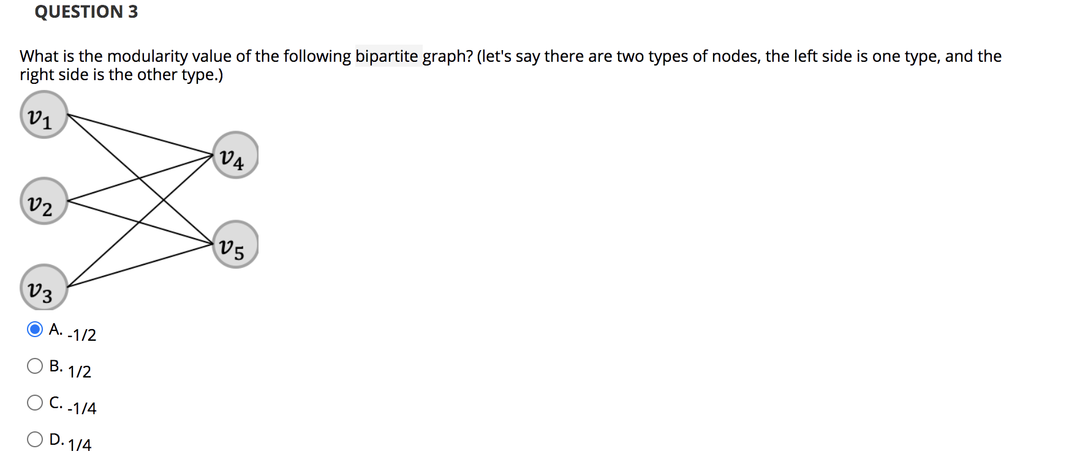
Online quiz 4

Slide 10
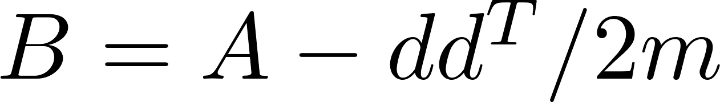
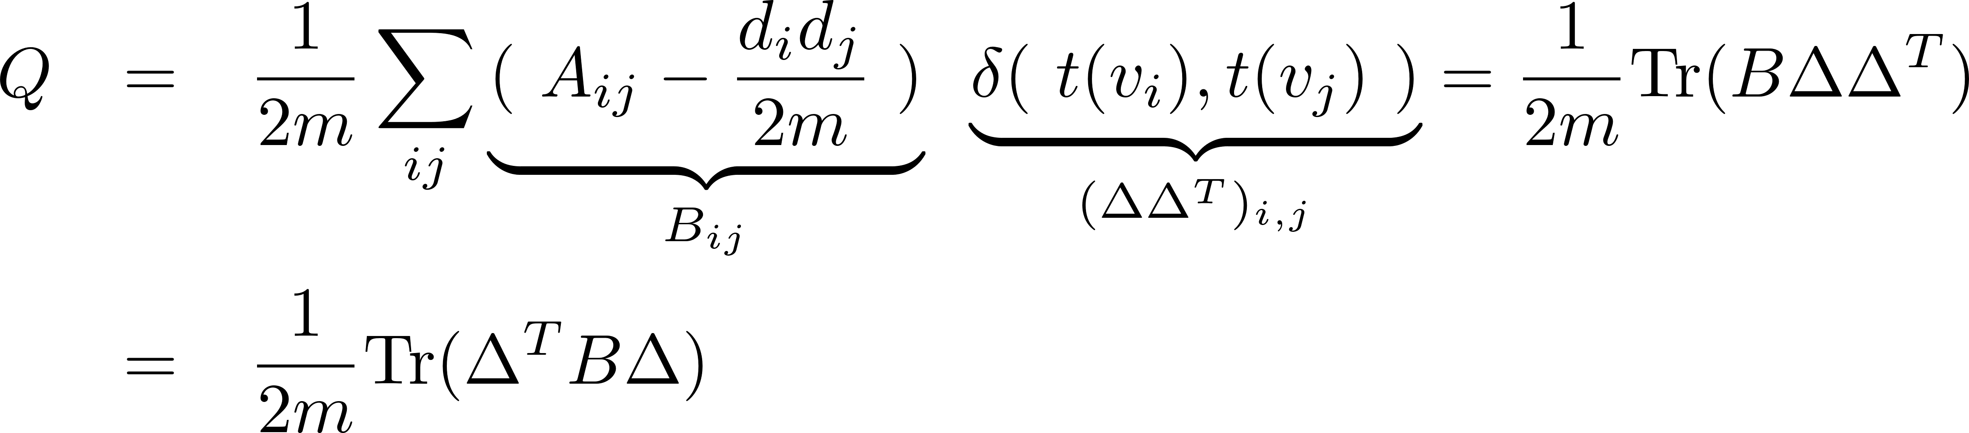
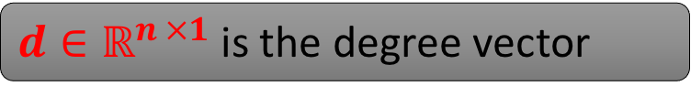
Modularity: Matrix Form
Let Modularity matrix be
$d∈ℝ^{n ×1}$ is the degree vector
Modularity can be reformulated as
Notes:
Pair-wise multiplication; sum of diagonal elements;

Slide 11
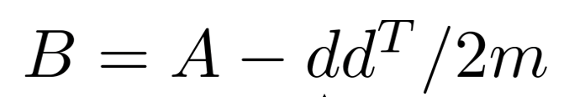
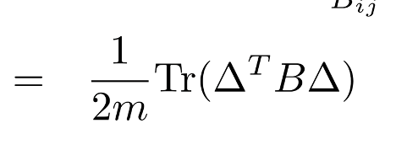
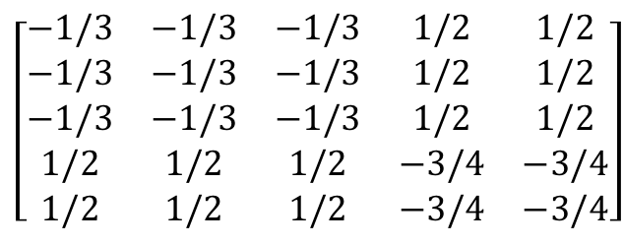
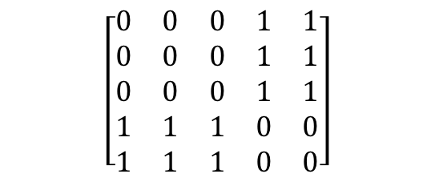
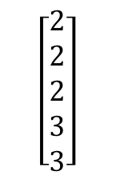
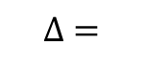
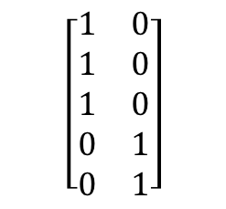
Online quiz 4
$$\left[\begin{matrix}0 & 0 & 0 & 1 & 1 \\ 0 & 0 & 0 & 1 & 1 \\ 0 & 0 & 0 & 1 & 1 \\ 1 & 1 & 1 & 0 & 0 \\ 1 & 1 & 1 & 0 & 0\end{matrix}\right]$$
$$\left[\begin{matrix}1 & 0 \\ 1 & 0 \\ 1 & 0 \\ 0 & 1 \\ 0 & 1\end{matrix}\right]$$
$$\left[\begin{matrix}2 \\ 2 \\ 2 \\ 3 \\ 3\end{matrix}\right]$$
A =
$$∆ =$$
d =
m = 6
$$\left[\begin{matrix}−1/3 & −1/3 & −1/3 & 1/2 & 1/2 \\ −1/3 & −1/3 & −1/3 & 1/2 & 1/2 \\ −1/3 & −1/3 & −1/3 & 1/2 & 1/2 \\ 1/2 & 1/2 & 1/2 & −3/4 & −3/4 \\ 1/2 & 1/2 & 1/2 & −3/4 & −3/4\end{matrix}\right]$$
=
Q
= -1/2

Slide 12
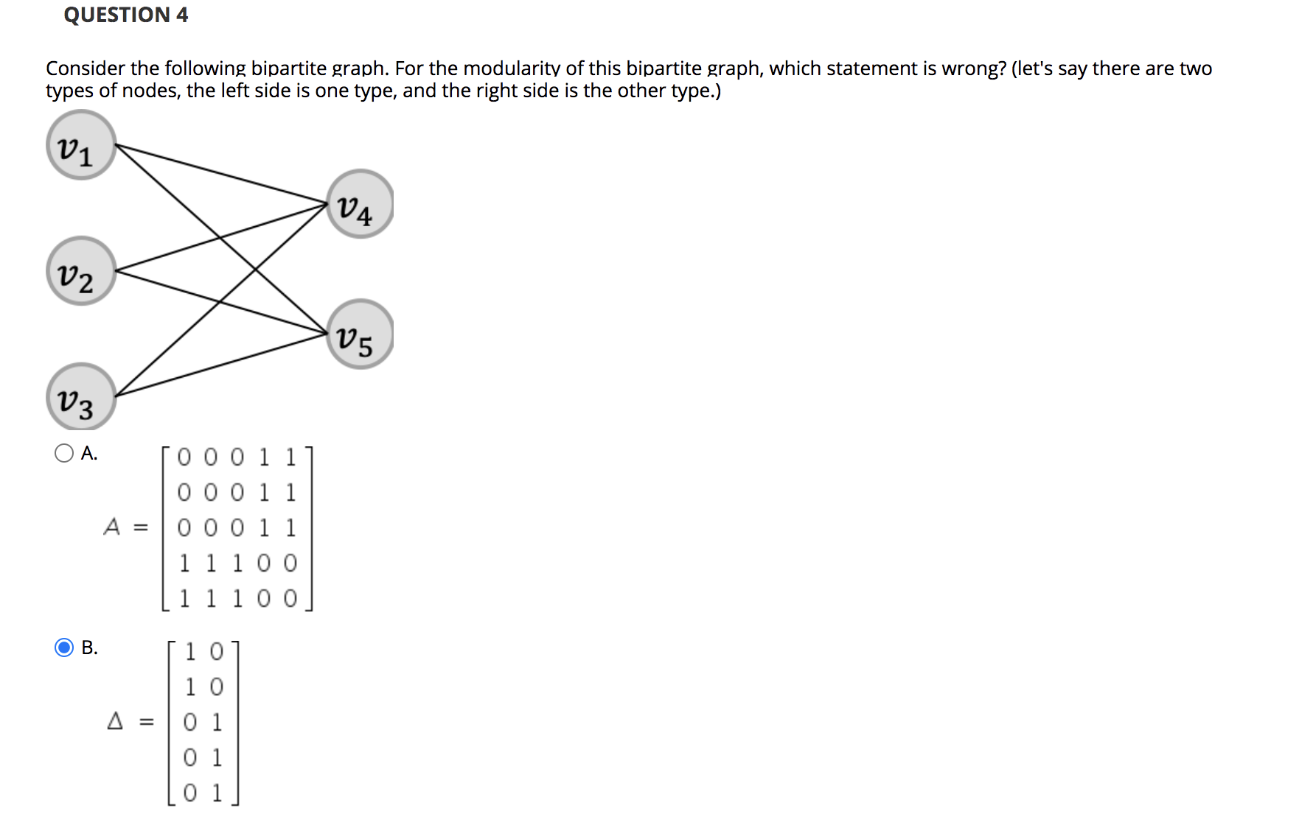
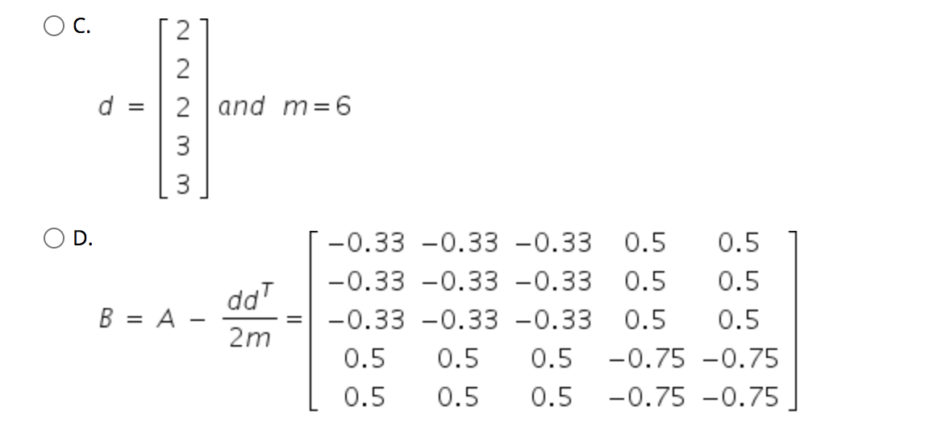

Slide 13
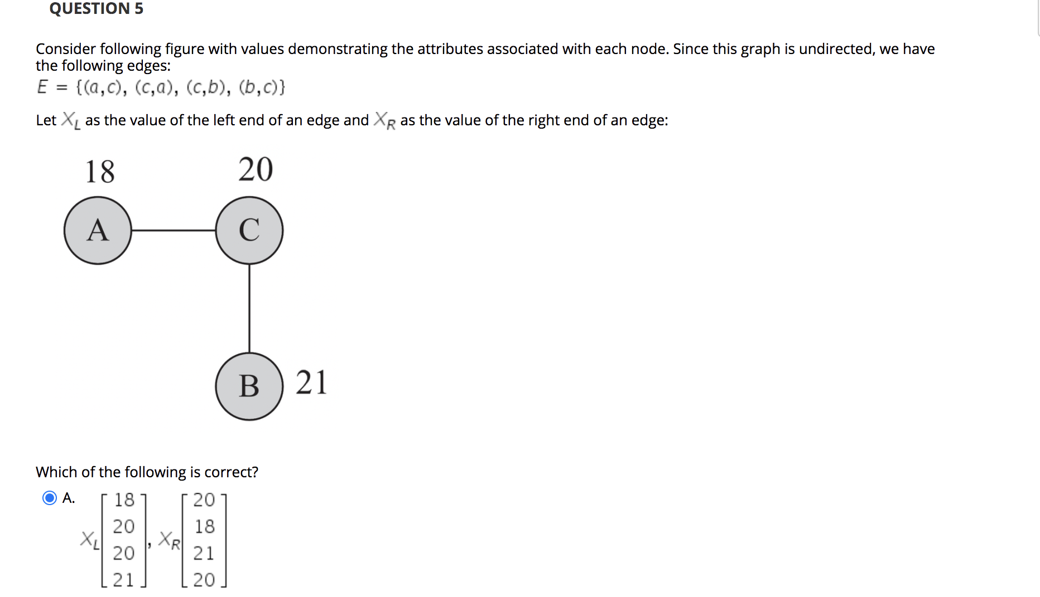
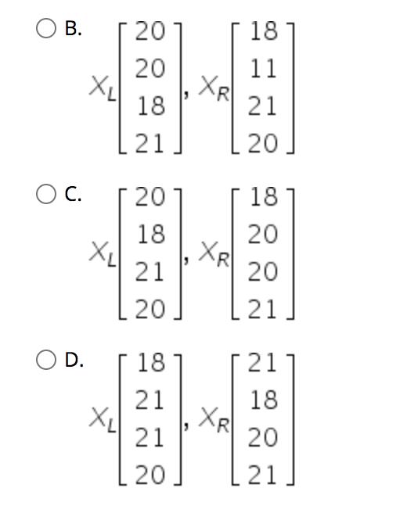
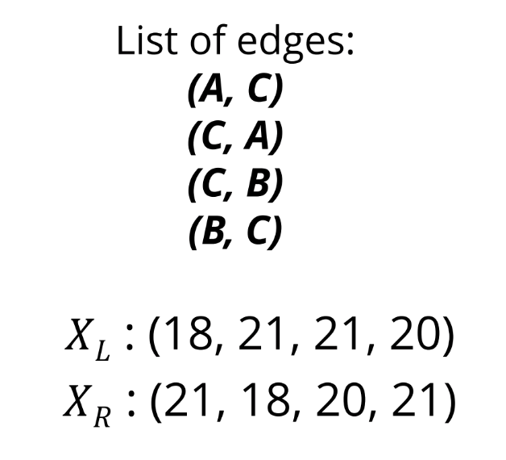
Online quiz 4

Slide 14
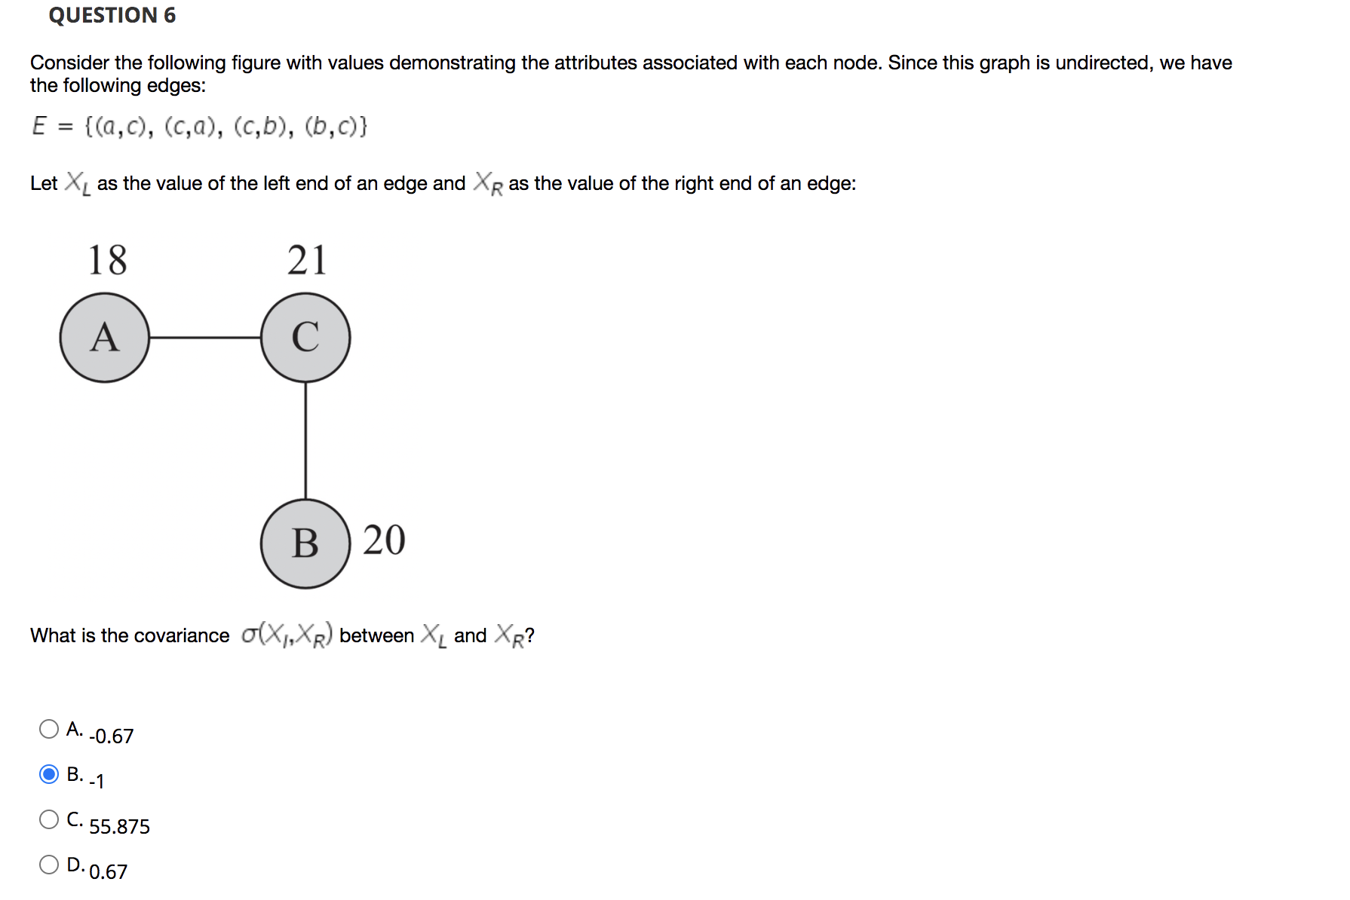
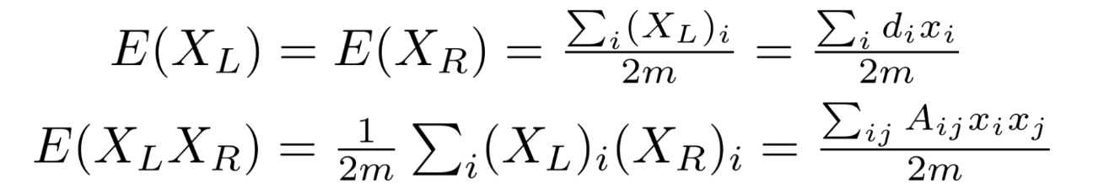
(18 + 21 + 21 + 20)/2*2 = 20
(1/(2*2)) * (2*A_{ac}x_{a}x_{c}+A_{cb}x_{c}x_{b}) = 399
399 – 20 * 20 = -1

Slide 15
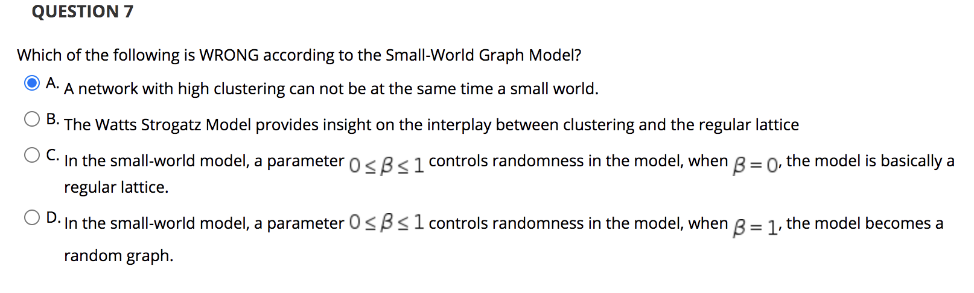
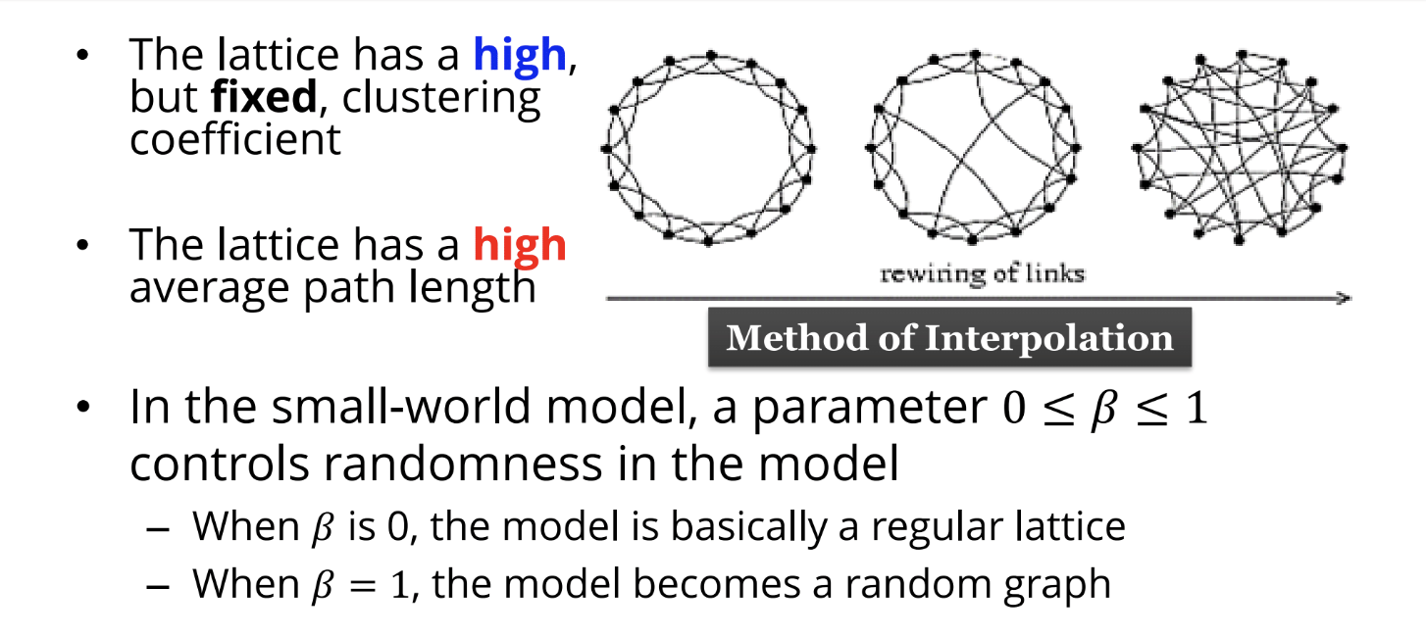

Slide 16
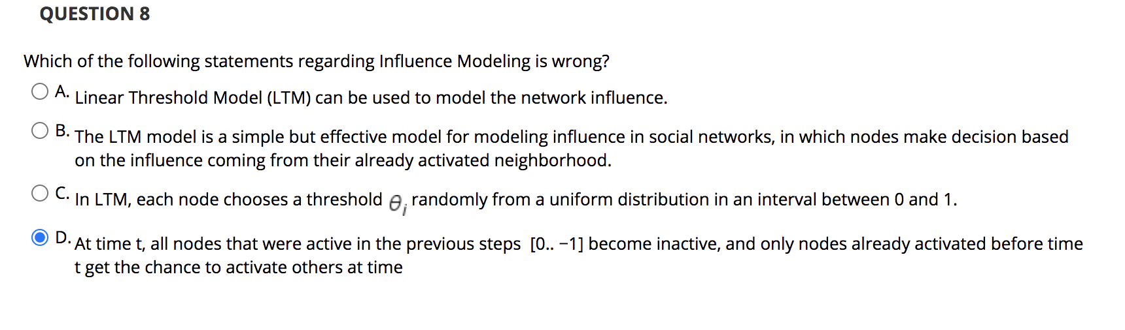

Slide 17
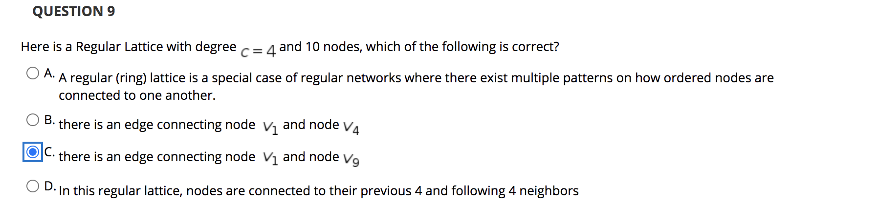
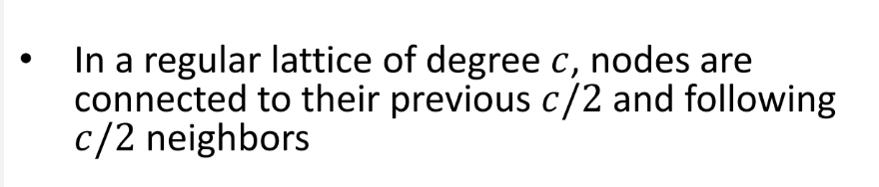

Slide 18
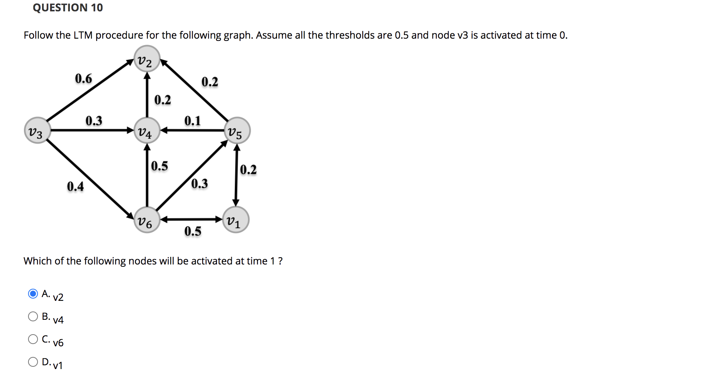
Suggestions from Xiangguo
S1:Which of (the following) nodes are/is activated after time 1: (v3,v2)
S2: you can continue the process until the model stops, and draw the sanpshots in each step.

Slide 19
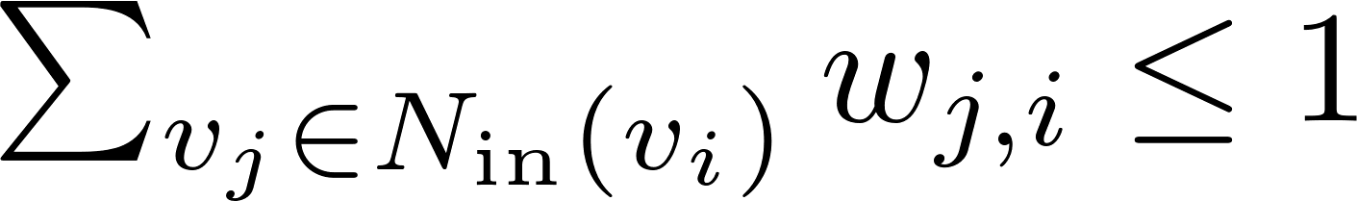
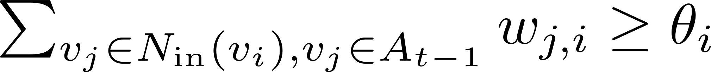
Linear Threshold Model (LTM)
Assume that for any given node $v_{i}$ , the sum of incoming influence ($w_{j,i}$) from its incoming neighbors is
Each node $i$ chooses a threshold $ϴi$ randomly from a uniform distribution in an interval between 0 and 1
At time $t$, all nodes that were active in the previous steps $[0..t−1]$ remain active. Only nodes already activated before time $t$ (i.e., $A_{t−1}$) can activate others at time $t$
Nodes satisfying the following condition will be activated

Slide 20
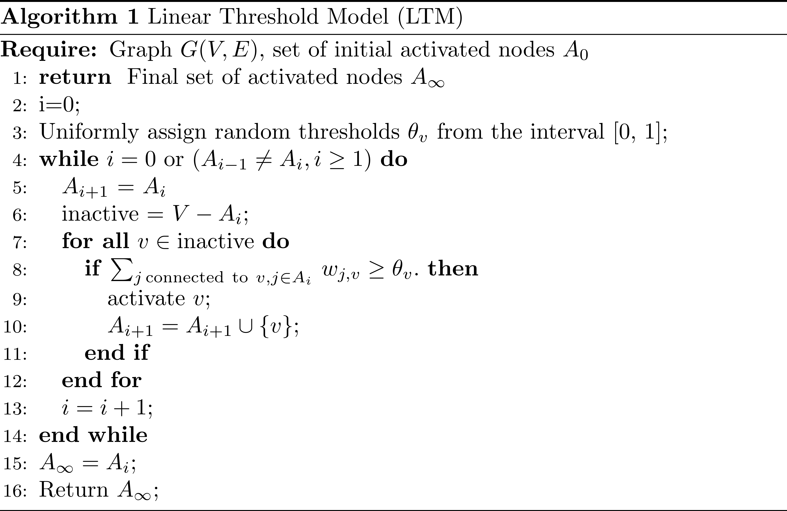
LTM Algorithm

Slide 21
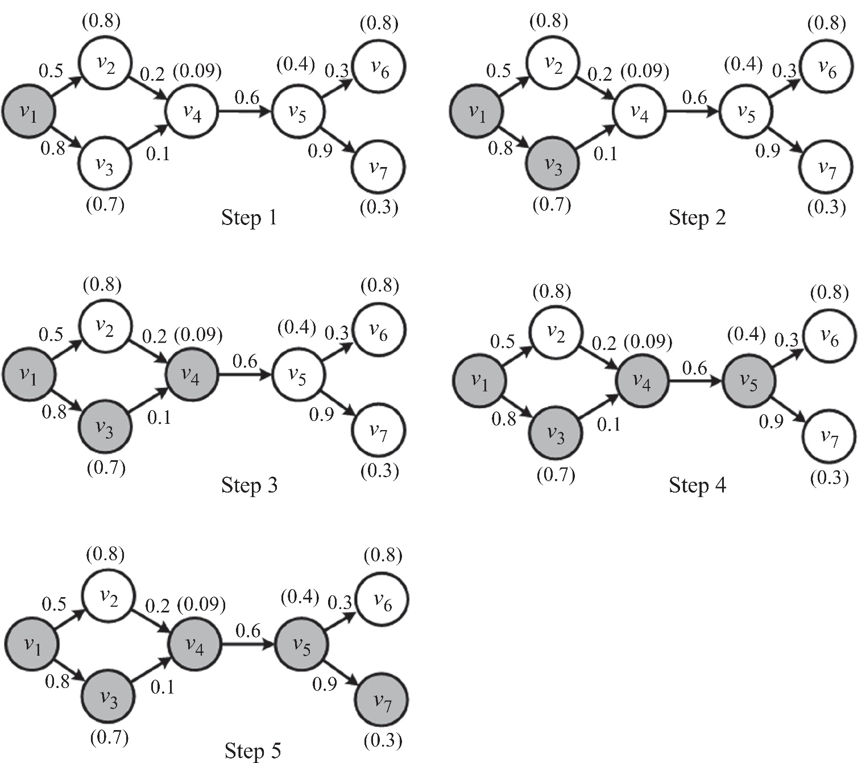
Linear Threshold Model (LTM) - An Example
Thresholds are on top of nodes

Slide 22
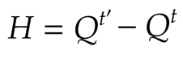
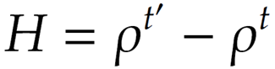
Measuring Homophily
We can measure how the assortativity of the network changes over time
Consider two snapshots of a network $G_{t}(V, E)$ and $G_{t^{′}}(V, E′)$ at times $t$ and $t′$, respectively, where $t′ > t$
$V$: fixed, $E$: edges are added/removed over time.
Nominal attributes. The Homophily index is defined as the change in Modularity:
Ordinal attributes. The Homophily index is defined as the change in Pearson correlation:
Notes:
The larger, the more homophily; normalized modularity;

Slide 23
Modeling Homophily
At each time step, a single node gets activated.
A node once activated will remain activated.
When a node $v$ is activated, we generate a random tolerance value $θv$ for the node, between 0 and 1.
The tolerance value is the minimum similarity that node $v$requires for being connected to other nodes.
For any edge $(v, w)$ that is still not examined, if the similarity $sim(v, w) >θv$, then edge $(v, w)$ is added.
The formation of edges is the result of similarity.
This continues until all vertices are activated.
Notes:
How to generate a graph or a network with homopihly;

Slide 24
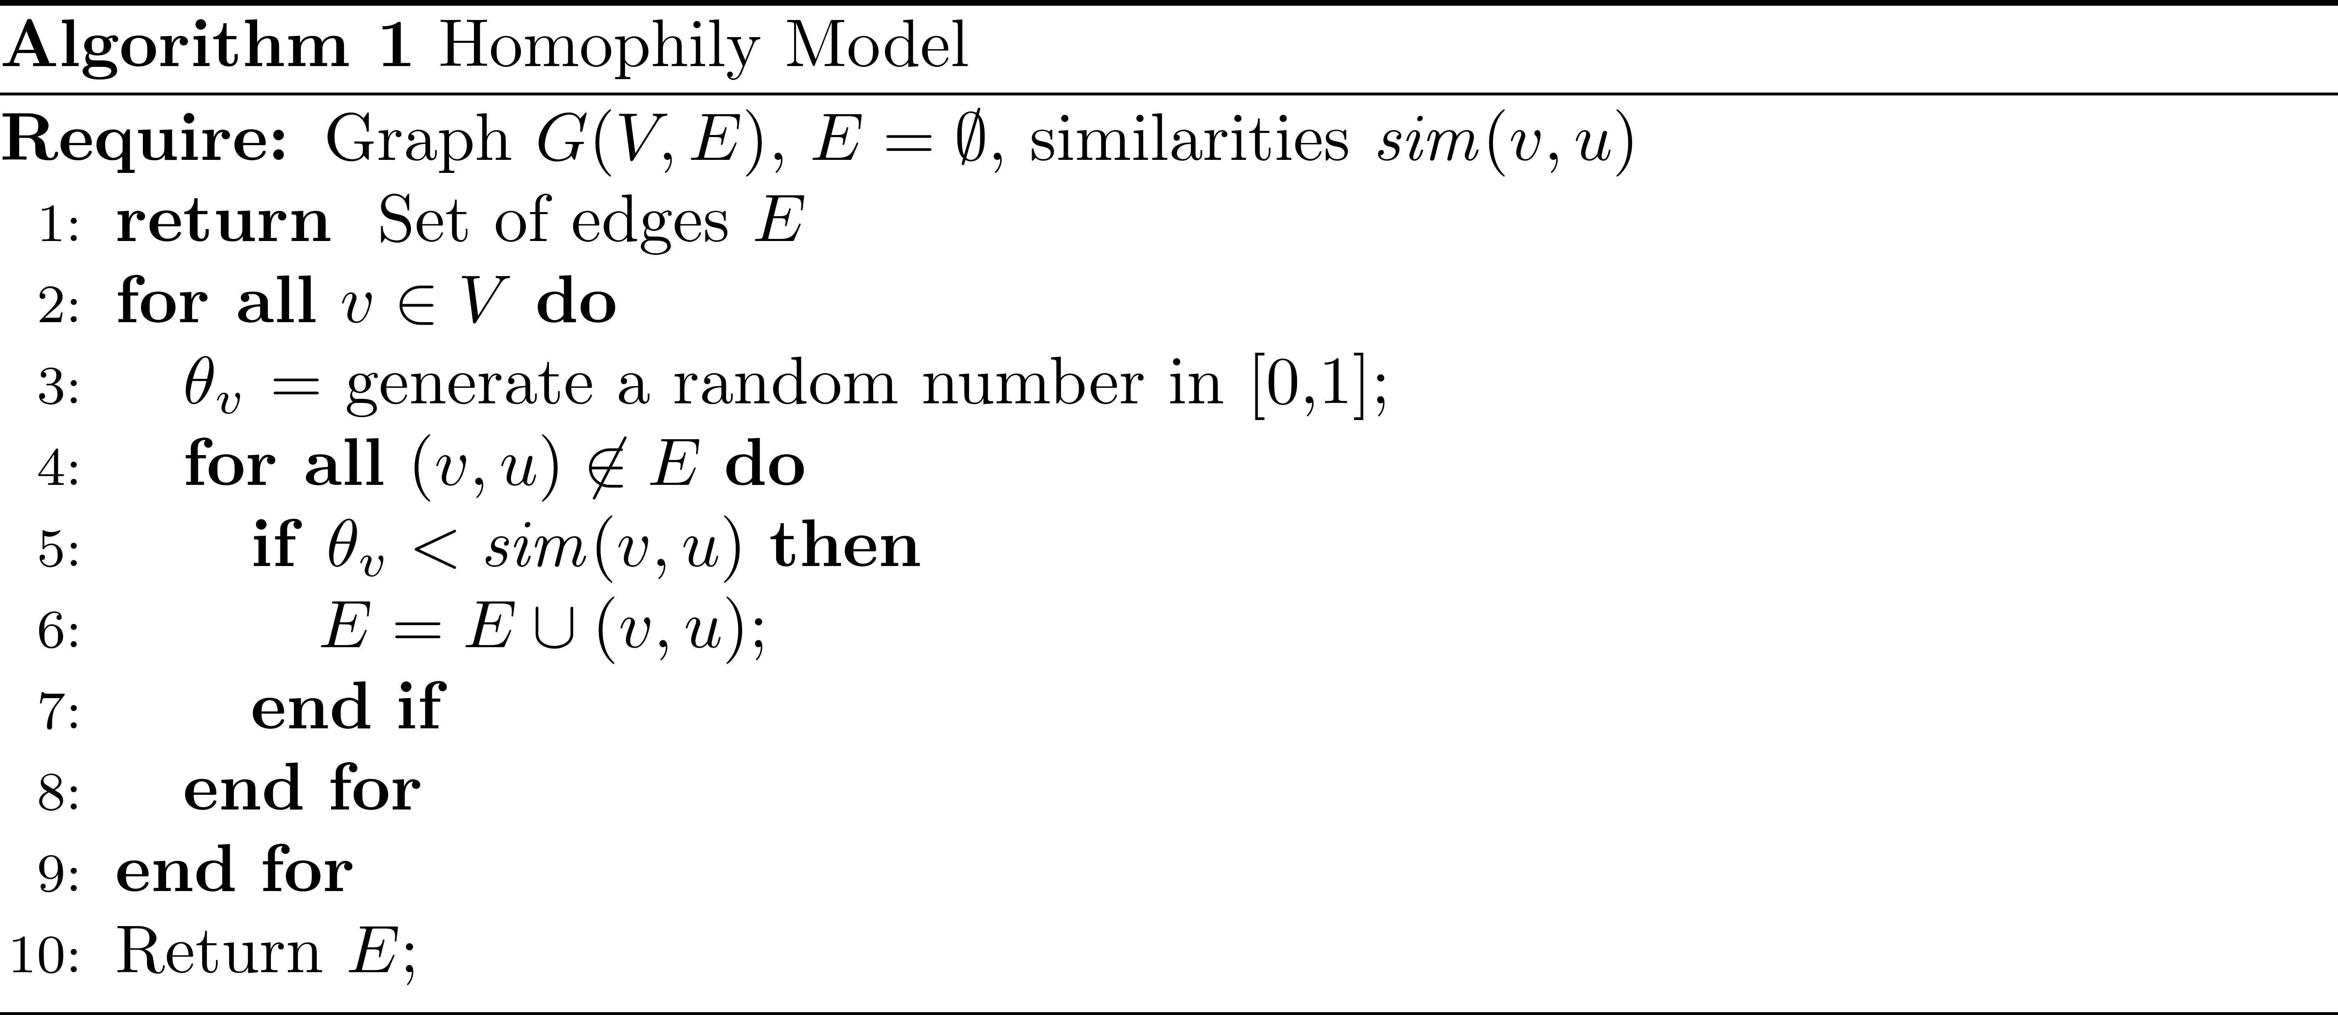
Homophily Model
Notes:
For all u\in V and (v,u)\not in E,

Slide 25
Information Diffusion
Information diffusion: process by which a piece of information (knowledge) is spread and reaches individuals through interactions.
We focus on techniques that can model and predict information diffusion in social networks.
Notes:
[epɪdiːmɪ'ɒlədʒɪ]; [eθ'nɒgrəfɪ

Slide 26
Information Diffusion
Sender(s). A sender or a small set of senders that initiate the information diffusion process;
Receiver(s). A receiver or a set of receivers that receive diffused information. Commonly, the set of receivers is much larger than the set of senders; and
Medium. It is the place through which the diffusion happens. For example, when a rumor is spreading, the medium can be social media platforms such as Twitter and Facebook.
Notes:
There are three roles in the information diffusion process.

Slide 27
Herd Behavior
Network is observable
Only public information is available
Global information is available

Slide 28
Information Diffusion Types
Herd Behavior
Information Cascade
We define the process of interfering with information diffusion
by expediting, delaying, or even stopping diffusion as Intervention
Notes:
[əb‘zə:vəbiliti]; Expedite; [‘ekspɪdaɪt]；
According to the network observability and information availability, there are four types of the information diffusion; We only focus on information diffusion types in which the network is observable. [ɪntə'fɪə]
Change the information diffusion;

Slide 29
Herd Behavior
Herd behavior describes when a group of individuals performs the same or similar actions without any plan
Main Components of Herd Behavior
Connections between individuals
A method to transfer behaviors among individuals or to observe the others’ behaviors (global information)
Examples of Herd Behavior
Flocks, herds of animals, and audiences during sporting events

Slide 30
Network Observability in Herb Behavior
In herd behavior, individuals make decisions by observing all other individuals’ decisions
In general, herd behavior’s network is close to a complete graph where nodes can observe at least most other nodes and they can observe public information
For example, they can see the crowd

Slide 31
How Does Intervention Work?
When a new piece of private information releases,
The herd reevaluate their guesses and this may create completely new results
The Emperor’s New Clothes
When the boy gives his private observation, other people compare it with their observation and confirm it
This piece of information may change others’ guess and ends the herding effect

Slide 32
Information Cascade
In the presence of a network
Only local information is available

Slide 33
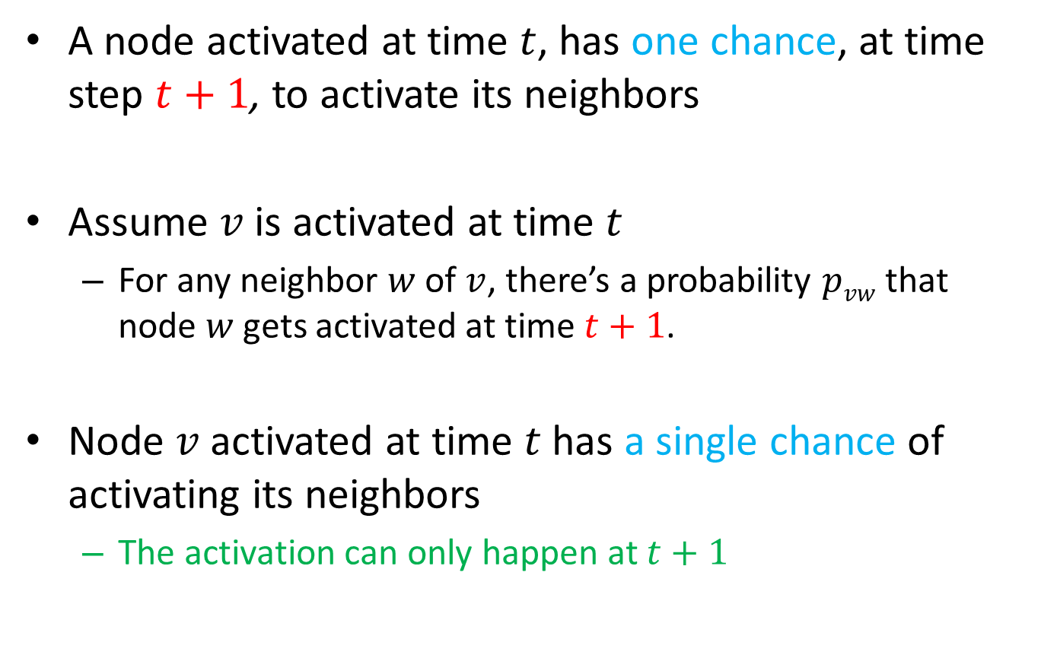
Independent Cascade Model (ICM)
A node activated at time $t$, has one chance, at time step $t+1$, to activate its neighbors
Assume $v$is activated at time $t$
For any neighbor $w$ of $v$, there’s a probability $pvw$ that node $w$gets activated at time $t+1$.
Node $v$activated at time $t$has a single chance of activating its neighbors
The activation can only happen at $t+1$

Slide 34
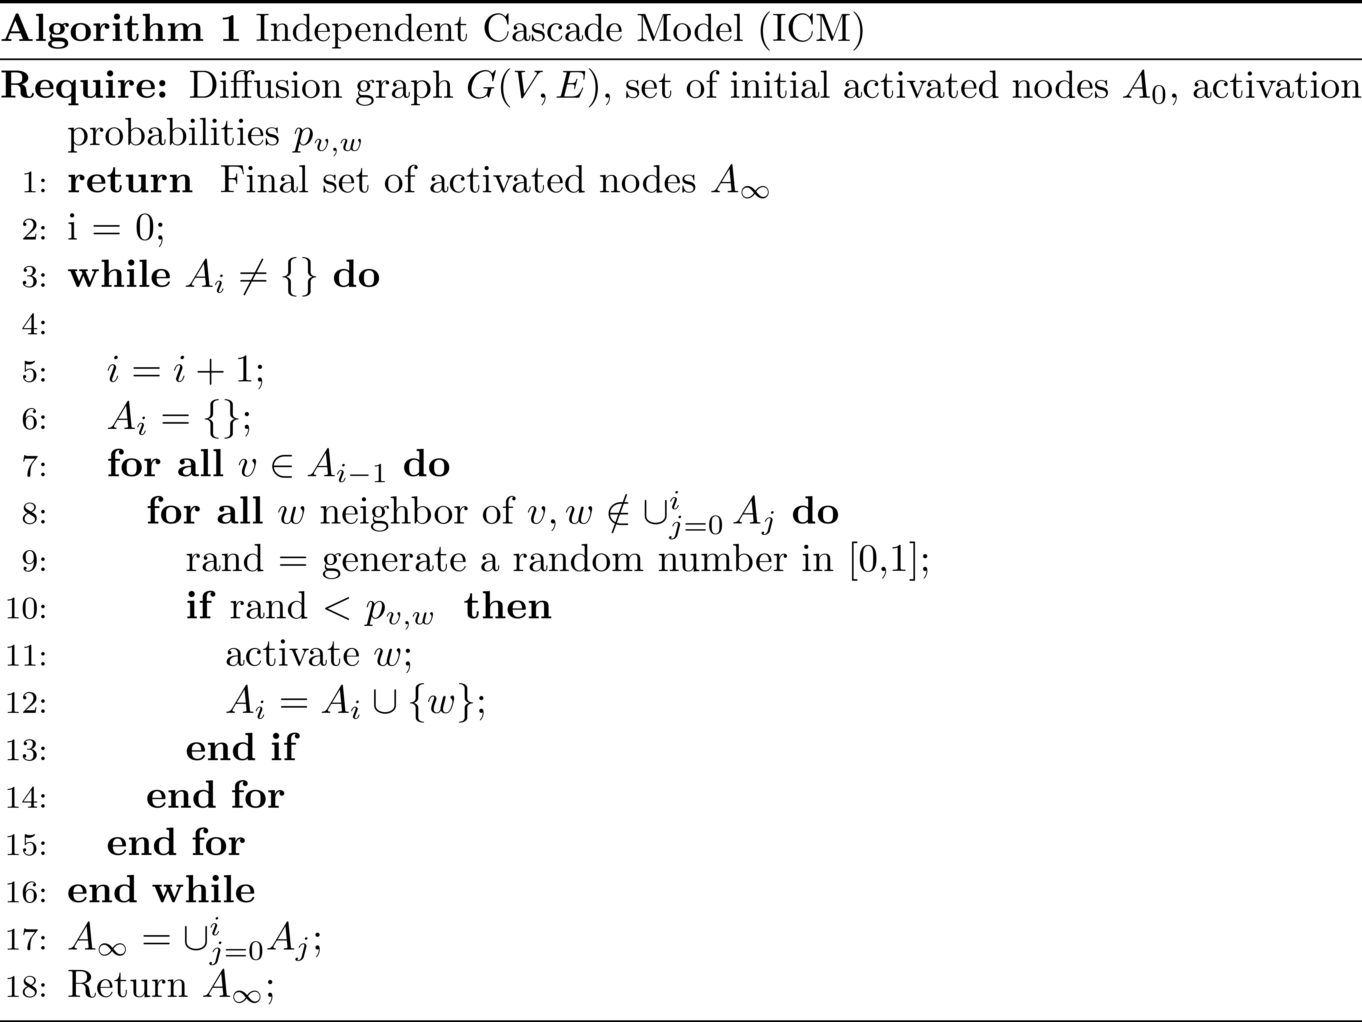
ICM Algorithm
\\ the set of nodes being activated at time i

Slide 35
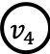
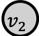
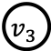
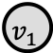
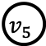


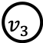

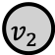
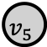






















Independent Cascade Model: An Example
0.5
$$v_{2}$$
0.2
0.3
$$v_{6}$$
0.4<0.5
$$v_{2}$$
0.2
0.3
$$v_{6}$$
$$v_{1}$$
$$v_{4}$$
0.6
$$v_{5}$$
0.6
$$v_{1}$$
$$v_{4}$$
$$v_{5}$$
0.8
$$v_{3}$$
0.1
0.9
$$v_{7}$$
0.9>0.8
$$v_{3}$$
0.1
0.9
$$v_{7}$$
Step 1
Step 2
0.5
$$v_{2}$$
0.1<0.2
0.3
$$v_{6}$$
0.5
$$v_{2}$$
0.2
0.3
$$v_{6}$$
0.6
$$v_{1}$$
$$v_{4}$$
0.4<0.6
$$v_{5}$$
$$v_{1}$$
$$v_{4}$$
$$v_{5}$$
0.8
$$v_{3}$$
0.1
0.9
$$v_{7}$$
0.8
$$v_{3}$$
0.9>0.1
0.9
$$v_{7}$$
Step 3
Step 4
0.5
$$v_{2}$$
0.2
0.2<0.3
$$v_{6}$$
$$v_{1}$$
$$v_{4}$$
0.6
$$v_{5}$$
0.8
$$v_{3}$$
0.1
1>0.9
$$v_{7}$$
Step 5
The edge weight represents the influence probability.

Slide 36





Chatting box

Slide 37

Summary of ICM

Slide 38

Most Influential Set

Slide 39

Most Influential Set of Nodes

Slide 40

Most Influential Set of Nodes
How hard is this problem?
NP-Hard (How to prove it)
Finding most influential set of nodes is at least as hard as set cover problem (a known NP-hard problem).
Set cover problem

Slide 41

Summary So far
Extremely bad news
Influence Maximization is NP-hard

Slide 42

Greedy Algorithm

